Slide 1

Anime – PI Project
Marilyn Nguyen

Slide 2

Introduction
Anime has grown rapidly in global popularity over the past few years, reaching audiences far beyond Japan and competing with mainstream entertainment worldwide. Major titles like Demon Slayer: Kimetsu no Yaiba and Chainsaw Man have gained massive followings, and in some cases, rivaled or even outperformed popular American films at the box office and on streaming platforms. As anime continues to expand in influence, it raises interesting questions about what makes certain shows more successful, popular, or highly rated than others.
To explore what makes some anime popular or highly rated, I analyzed a dataset of over 15,000 anime. The data was pulled from the Jikan API v4 endpoint/top/anime and includes info like scores, genres, episode counts, and audience engagement.

Slide 3

Mini Update #1

Slide 4
Data Profile
This data has 15,000 rows and 22 columns.
Column Name | Has missing value? | Data Type(Discrete or numeric or free text) | Useful? | Need cleaning or processing?
anime_id | No | Numeric | No | No
anime_url | No | Free Text | No | No
image_url | No | Free Text | No | No
name | No | Free Text | Yes | No
english_name | No | Free Text | Yes | No
japanese_names | No | Free Text | No | No
score | No | Float | Yes | No
genres | No | Free Text | Yes | No

Slide 5
Data Profile Continued…
Column Name | Has missing value? | Data Type(Discrete or numeric or free text) | Useful? | Need cleaning or processing?
synopsis | No | Free Text | No | No
type | No | Free Text | Yes | No
episodes | No | Numeric | Yes | No
premiered | No | Free Text | Yes | No
producers | No | Free Text | Yes | No
studios | No | Free Text | Yes | No
source | No | Free Text | Yes | No
duration | No | Free Text | Yes | No

Slide 6
Data Profile Continued…
Column Name | Has missing value? | Data Type(Discrete or numeric or free text) | Useful? | Need cleaning or processing?
rating | No | Free Text | No | No
rank | No | Numeric | Yes | No
popularity | No | Numeric | Yes | No
favorites | No | Numeric | Yes | No
scored_by | No | Numeric | No | No
members | No | Numeric | No | No

Slide 7
Curious Questions
Does a higher score mean an anime is more popular? ✅
Which genres have the highest average scores?
Which genres are the most popular?
Are movies rated higher than TV shows?
Do longer anime (more episodes) get higher ratings? ✅
Does the source material affect ratings? ✅
Are newer anime rated higher than older ones?
Which anime are underrated (scores are high but popularity is low)? ✅
Which anime are overhyped (scores are low but popularity is high)? ✅
Do anime with more favorites also have higher scores?

Slide 8
Audience
Communication Goals
The goal of this analysis is to help anime viewers make better decisions about what to watch by giving them a clearer understanding of how ratings, popularity, and other factors actually relate. Many viewers rely on popularity or rankings, so this project aims to shift that perspective by showing that highly rated anime are not always the most popular, and some less popular shows may be worth watching. By highlighting these patterns, the analysis helps fans discover anime they might have otherwise overlooked. This will encourage viewers to look beyond the basic metrics and explore more diverse animes.
The audience for this anime analysis includes…
Anime fans who want to discover trends, hidden gems, or popular shows.
Media analysts or studios who might use these insights to understand what drives anime popularity and ratings.
Media consumers who are looking for something new to watch.
Data analysts who are interested in seeing how patterns and insights can be extracted from real-world entertainment data.

Slide 9

Mini Update #2

Slide 10

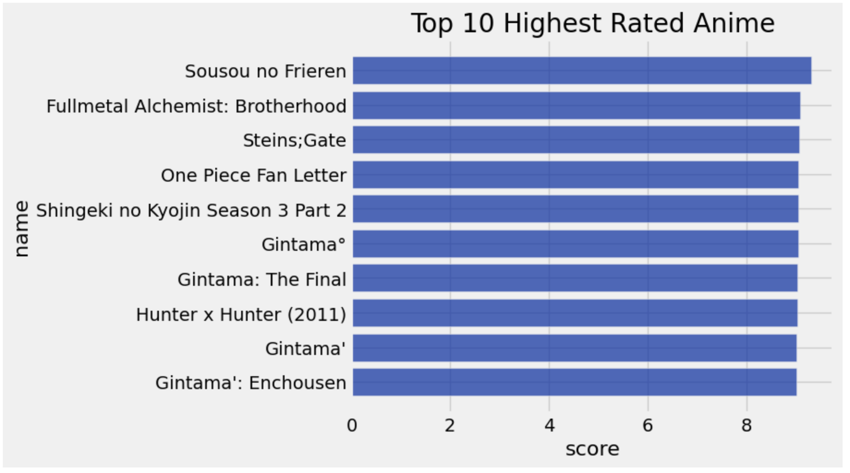

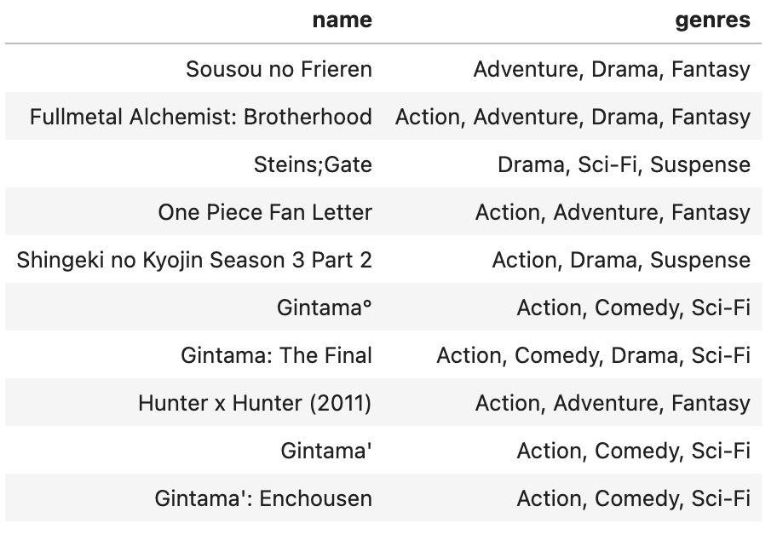
Top 10 Highest Rated Anime in the Data Set & Their Genres
Looking at the top 10 highest rated anime, all of them score very closely as you can see in the bar chart. Most of them are between 8.5 and 9, showing that they are all considered extremely high quality by viewers. Sousou no Frieren (Frieren: Beyond Journey’s End) stands slightly above the rest, but overall there isn’t a huge gap in scores, which suggests that multiple anime are seen as top-tier, not just one specific anime stands out. However, what’s more interesting is the variety in genres across these top-rated anime. While action and adventure appears quite frequently, there’s also a mix of drama, fantasy, sci-fi, and even comedy like in all of the Gintama animes.
This shows that there isn’t just one “type” of anime that gets high ratings. There are different styles and genres that are all successful. For viewers, this means that sticking only to popular or trending genres might cause them to miss out on other highly rated anime that don’t get as much attention. Even though these anime are in the highly rated group, they may not all be the most popular (I will analyze this in later slides). This supports the idea that ratings and popularity don’t always match. Basically, this is encouraging viewers to look beyond the rankings and explore a wider range of anime, since some of the best-rated shows might not be the ones everyone is talking about.

Slide 11

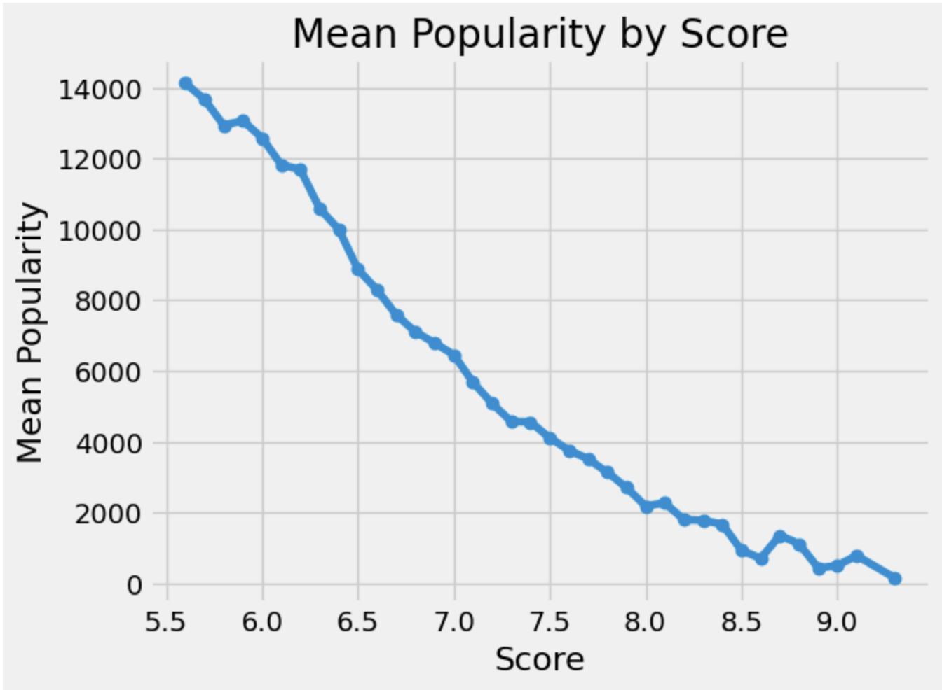
Curious Question: Does Higher Score Mean More Popularity?
This chart shows a really clear trend: as the score goes up, the average popularity number goes down. At the lower scores (around 5.5-6), the mean popularity is really high (around 14,000), but as the scores increase toward 9, the popularity drops to under 1,000.
Since lower popularity numbers usually mean more popular (ranked higher), this suggests that higher-scored anime tend to be less popular. The line steadily slopes downward, which makes the relationship pretty consistent, not random.
This means that the higher scores do not necessarily lead to higher popularity, which supports the earlier finding that highly rated anime are not always the most widely watched. For viewers, this suggests that relying on only popularity rankings can be misleading, and some of the best anime may be less well known.

Slide 12

Project Progress Check for Update 2
This week, I tackled some of the curious questions that I had from Mini Update #1 including finding out the top 10 rated animes from the dataset and finding what genres they were. To find this, I first made a bar chart to see the anime name and their rating and then a table that lists their respective genre. Another curious question I aimed to answer was “Does higher score equal more popularity?”. For that, I made a scatter plot to see if there was any correlation between those two variables. Some obstacles I faced this week was trying to figure out what specific graphs I wanted to use to convey my data story and writing the correct code to generate those graphs. The resource I used was JupyterHub’s Python Notebook to make the plots.

Slide 13

Response to Feedback from Mini Update #1
From Mini Update #1, I received feedback regarding my Communication Goals and my Audience. Dr. Chen, suggested that the data analysts may not be a suitable audience member for my data story. Additionally, Dr. Chen suggested that my communication goal is more geared towards analysis and not the actual communication of the story to my audience. To address this, I fixed that slide and made sure to carefully reflect my communication goal to specifically relate to my audience and not focus primarily on the type of outcomes I want from my analysis. I think this feedback was definitely useful as it gave me a different perspective in what my message sound like to my audience. I don’t know of any additional feedback I may be seeking.

Slide 14

Mini Update #3

Slide 15

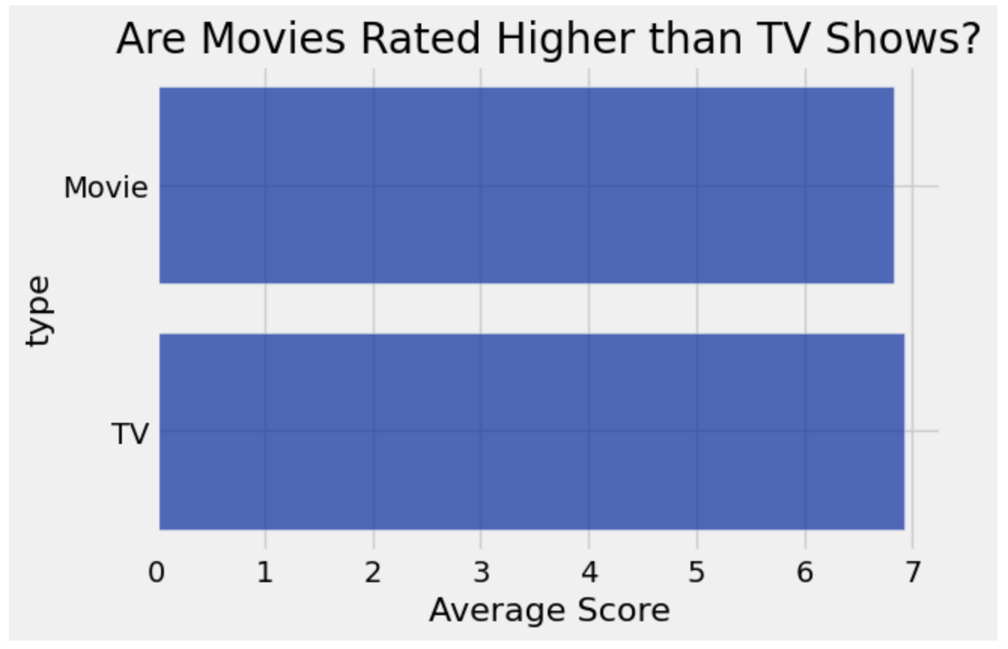
Curious Question: Are Movies Rated Higher than TV Shows?
Looking at the chart, both movies and TV shows have almost the same average scores, with both of them sitting just a little bit under a score of 7. The bars are nearly the same length, showing that there is very little difference in how audiences rate these two types of anime. This suggestst hat the format alone about whether it is a movie or TV series, does not have a strong impact on overall ratings.
For viewers, this means that choosing between a movie or a TV show shouldn’t be based on the assumption that one is better than the other. Instead, other factors like the genre, story, or personal preferences are likely to matter more. This also supports the idea that simple categories don’t always determine the quality, so this encourages viewers to look beyond the basic filters when deciding what to watch.

Slide 16

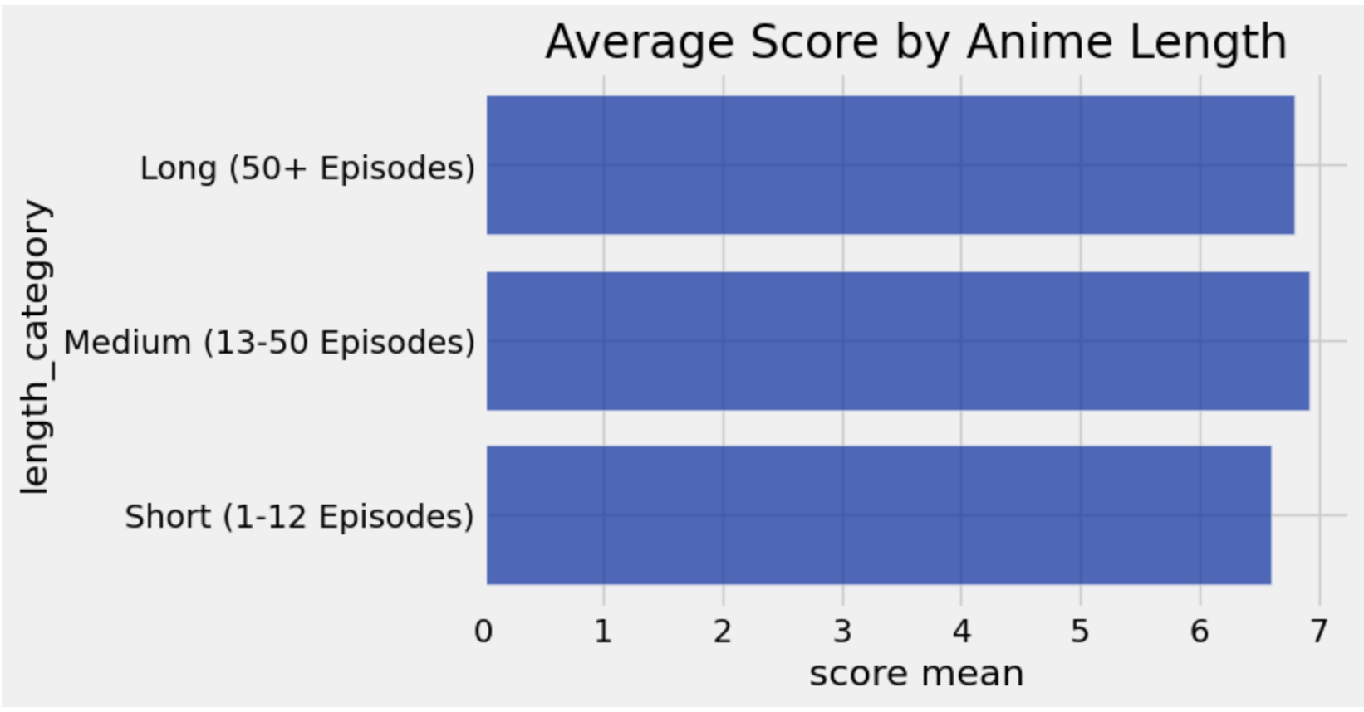
Curious Question: Do longer anime (more episodes) get higher ratings?
The average scores for short anime (1-12 episodes), medium (13-50 episodes), and long (more than 50 episodes) are all really really close to each other, all around the mid to high 6 score range. Medium and long anime are just slightly higher than short ones, but the difference is super small.
This shows that while longer anime do have a tiny edge in ratings, episode length doesn’t seem to make a big impact overall since the averages a nearly the same across all groups.

Slide 17
Project Progress Check for Update 3
This week, I answered more curious questions using data analysis and code from Python Notebook. I was able to gather more information to build my data story about finding different ways to help people choose which anime to watch. This week, my data analysis was not very supportive of my hypothesis because the data was so close together, there wasn’t a clear yes or no answer to the influences of the ratings of different anime. The length of the anime series and the type of format (TV or movie) didn’t really have a clear influence on the ratings the anime received. I will take that into account as I move into next week’s updates and find more reasons and data about what could contribute to an anime’s received rating.

Slide 18
Response to Feedback from Mini Update #2
From my Mini Update #2, I received feedback that my scatter plot was too convoluted and crowded, making it hard to read. Looking at it now, I can see that it is very clumped together and difficult to analyze. Dr. Chen recommended I use bins or create a 2D plot instead. So, I went back to to the Python Notebook and coded a linear depiction of the scatter plot to clean it up. I replaced the old graph on the slide with the new version and it is definitely much easier to read and interpret. This feedback is definitely useful as I can refine my plot to be more usable for analysis instead of a jumble of dots on the scatter plot. Other than that, I’m not looking for any particular feedback.

Slide 19

Mini Update #4

Slide 20
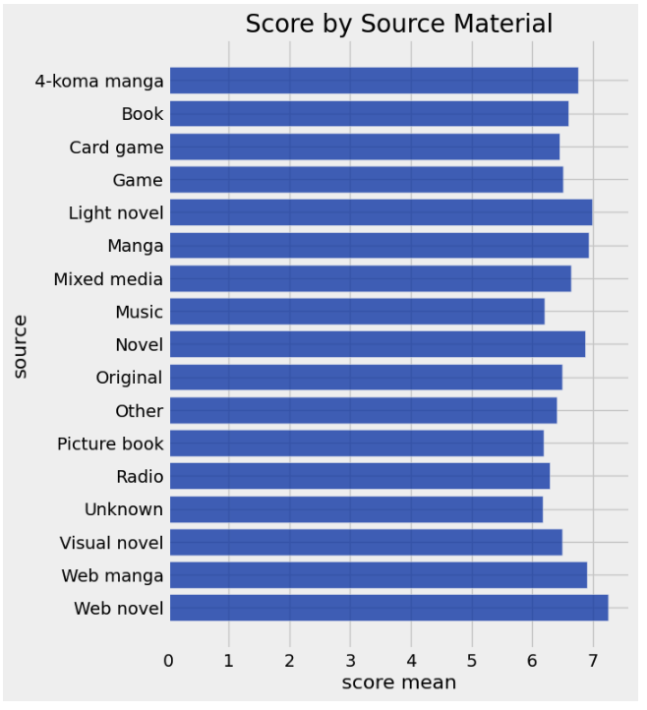
Do manga-based anime perform better than originals?
Most of the average scores across different source materials fall really close together, mostly between 6.0 and 7.2. Manga, light novel, and web novel adaptations are near the higher end, but not by a huge margin. Originals are also in that same range, sitting just slightly lower than some of the top manga-based ones.
This shows that manga-based anime don’t clearly outperform originals since both types score pretty similarly overall. However, web novel sources compared to music or game sourced anime have a clear gap between score means.

Slide 21
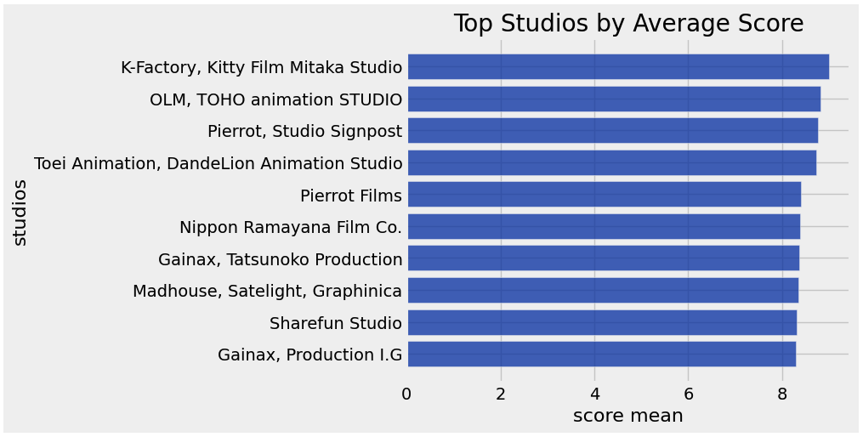

Do some studios consistently produce higher-rated anime?
The top studios all have really high average scores, mostly between 8.2 and 8.8, which is a pretty tight range. A few studios like K-Factory and Kitty Film are slightly higher, but overall the differences between the studios are small.
This shows that while some studios do rank a little higher, there isn’t a huge gap. Most of these top studios consistently produce highly rated anime. So, studio can matter, but it’s not the only thing deciding how good an anime will be.

Slide 22
Project Progress Check for Update 4
This week, I explored more potential factors that people could look at to see what influences the popularity and scoring of an anime series. I tried to answer these two questions: “Do manga-based anime perform better than originals?” and “Do some studios consistently produce higher-rated anime?”. Clearly, a lot of the factors I thought would strongly affect anime ratings actually don’t make a huge difference. For example, different source materials (like manga vs. originals) all had really similar average scores, even though web novels did stand out a bit compared to things like music source or game-based anime. I also saw that top studios all produce highly rated anime, but their scores are really close to each other, so no single studio dominates by a lot. Overall, this week’s analysis hshowed me that things like source material and studio might have some influence, but again, they don’t fully determine how well an anime is rated.

Slide 23
Response to Feedback from Mini Update #3
From last week’s Mini Update #3, I received an inquiry from Dr. Chen about my choice of categorization in the plot. Dr. Chen asked, “Is there a reason to bin into those three categories? if your data is large, it doesn't hurt to use smaller-sized bins”. My response to the feedback is that those bin sizes and 3 categories are intentional. They reflect the most common anime production patterns where many series are 12 episodes long while the longer ones are 50+ episodes. The middle bin captures everything in between. Those are the typical series lengths commonly seen in anime. I can see where the feedback is coming from, however that is usually how anime series are. They are either exactly 12 episodes (or less) and are referred to as short amongst the anime community or super long with 50+ to almost thousands of episodes, or in between those values.

Slide 24

Mini Update #5

Slide 25
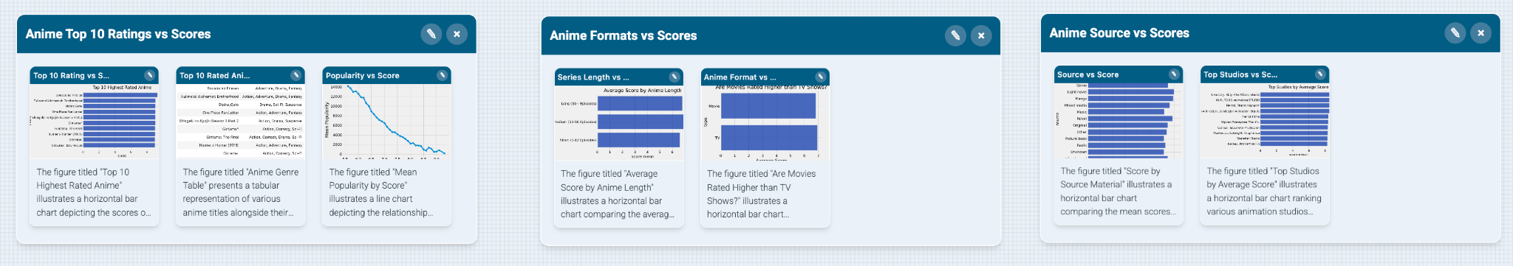
Storyboard
This group of data visualization revolve around the anime with Top 10 ratings and their scores.
This group of data visualizations revolve around the type of anime format and their specific scores.
This group of data visualizations revolve around the anime source and their scores.
This data story is organized from left to right to explore different factors that may influence anime ratings to help audience choose their next watch. The first section focuses on the top 10 highest rated anime and introduces the variety of genres and scores among them. The middle section looks at anime format, such as TV shows and movies, to see if format affects ratings. The last section explores anime source material, like manga or original stories, and how it relates to scores. The story examines multiple factors to show that there is not just one reason why anime became highly rated.

Slide 26
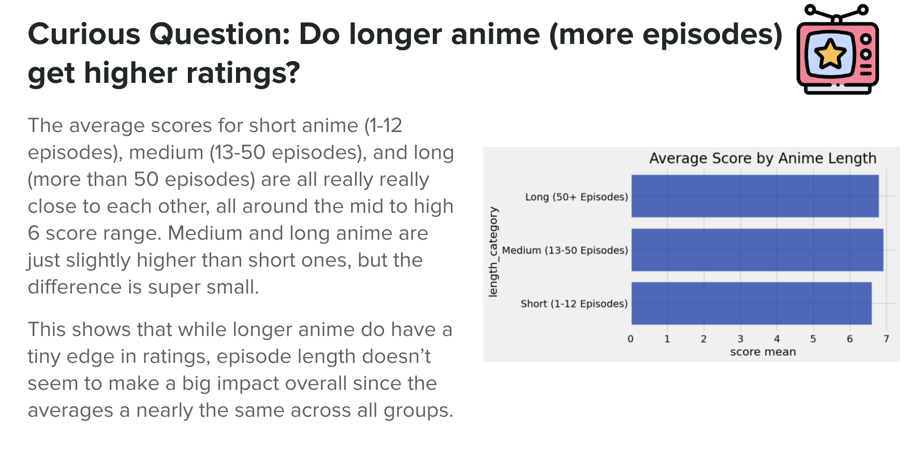

Micro Story (Also in the Google Doc)
For my PI project, I looked at anime ratings and compared them to different factors, such as the genre, popularity, format, and episode length. The overall goal of my analysis was to figure out what factors actually influence anime ratings and whether popularity really reflects the quality of the anime. In this slide that I’ve chosen, the data compares the average scores of short anime (1-12 episodes), medium anime (13-50) episodes, and long anime (50+ episodes). I grouped them into 3 of the most common anime series lengths to calculate the average ratings, and the graph helps to show whether longer anime tend to receive better scores from viewers. As you can see, the results show that medium and long anime have slightly higher average ratings than shorter anime, although the differences are pretty small overall.
This particular data matters to me because I personally prefer watching medium-length anime over shorter 12-episode ones. A lot of the 12-episode anime feel rushed to me, especially when it comes to character development or the ending. I usually feel more satisfied watching anime that have enough episodes to fully build the story and characters. Because of that, it was interesting to see that medium-length anime also scored a little bit higher on average in the data.
I think this matters to other people because many anime viewers choose what to watch based only on popularity and what is currently trending. Looking at episode length helped show that there is not one single reason why anime becomes highly rated. Instead, multiple factors work together, and viewers may discover better anime experiences if they look beyond basic popularity ranking and explore anime more thoughtfully.

Slide 27

Project Progress Check for Update 5
This week, I utilized Story Studio to upload my data visualizations and create a storyboard of my data. I was able to see my data from the past couple of weeks as a whole picture and arrange them in a way to help me organize my data story. I also wrote a 200+ word data story about one of my presentation slides about anime series lengths to explain why this matter to my audience and my general findings. This was a great way to sum up all of the data analysis I’ve been doing for the past month.

Slide 28

Mini Update #6

Slide 29
Final Storyboard
This group of data visualization revolve around the anime with Top 10 ratings and their scores.
This group of data visualizations revolve around the type of anime format and their specific scores.
This group of data visualizations revolve around the anime source and their scores.
This data story is organized from left to right to explore different factors that may influence anime ratings to help audience choose their next watch. The first section focuses on the top 10 highest rated anime and introduces the variety of genres and scores among them. The middle section looks at anime format, such as TV shows and movies, to see if format affects ratings. The last section explores anime source material, like manga or original stories, and how it relates to scores. The story examines multiple factors to show that there is not just one reason why anime became highly rated.

Slide 30
Final Summary of Data Story
In the world of anime, ratings and popularity often tell different stories. the exploration of anime ratings and popularity reveals a complex landscape where multiple factors, including genre, source material, studio, format, and length, influence perceptions of quality. By considering these diverse elements, viewers can discover a wider range of anime that align with their personal preferences and interests. The exploration of anime ratings and popularity reveals a complex landscape where multiple factors, including genre, source material, studio, format, and length, influence perceptions of quality. By considering these diverse elements, viewers can discover a wider range of anime that align with their personal preferences and interests. The figures collectively convey the nuanced relationship between anime ratings,
popularity, and various influencing factors such as genre, source material, studio, format, and length.
They illustrate that high ratings do not necessarily equate to high popularity and that quality anime
can come from diverse genres and sources. The data encourages viewers to explore beyond
conventional popularity metrics and consider a wider range of anime based on personal preferences
and interests.

Slide 31
Project Progress Check for Update 6
This week, I refined my Story Studio storyboard and created a final storyboard and summary data story. I tried my best to capture the data in an intuitive structure and order to tell the my data story about looking beyond popularity and ratings to choose the next watch. I made sure my data visualization groupings made sense to go together and the labels were appropriate and clear. This week’s work simply consisted of minor adjustments being made and final storytelling tweaks.

